Slide 1

Examination System
Graduation Project Discussion

Slide 2





Our team
Mohamed Eleraqi
Mohamed Reda
Amr Elsherbiny
Ahmed Nassr
Salema Hassan
BI Developer & Software Engineer
BI Developer & Data Analytics
BI Developer & Data Analyst
BI Developer Ex Mechanical Engineer
BI Developer
Mohamed.8.Eleraqi@gmail.com
Write
in/mohamed-8-eleraqi/
moredafci@gmail.com

Slide 3
Content overview
1
2
3
Introduction
DataBase
Stored Procedure
4
5
6
Data warehouse
BI Tools
Dashboards
7
8
9
Application
Future Work
Conclusion

Slide 4
Introduction
…

Slide 5
Database
SQL Server

Slide 6
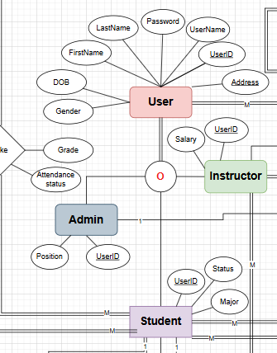
Database| ERD
Enhanced ERD
User as Supertype: Centralizes common attributes for all user types.
Inheritance Model: Instructor, Admin, Student inherit from User.
Role Management: Efficiently handles distinct user roles through specialization.

Slide 7
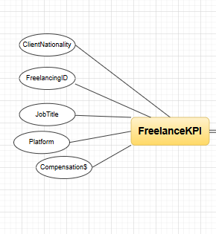
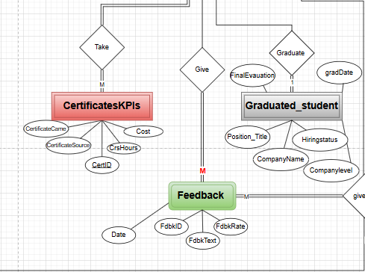
Database| ERD
Freelance & Certificate KPIs: Quantifying professional development.
Feedback & Student Tracking: Gathering insights and monitoring outcomes.
Data-Driven Decisions: Informing improvements based on these entities.

Slide 8
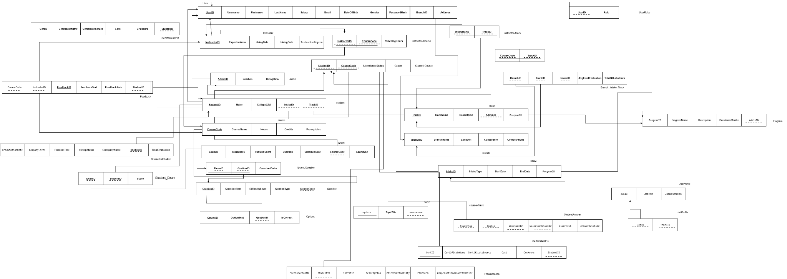
Database| Mapping

Slide 9
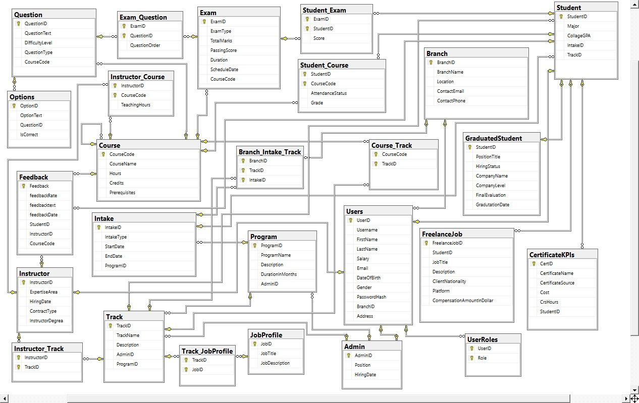
Database| Implimentation
Logical-to-Physical Mapping: ERD translated into a functional SQL schema.
Normalized Database: Designed for reduced redundancy and consistency.

Slide 10

Data Generation
Realistic Data Generation: Used Faker to create lifelike test data.
Populating Databases: Efficiently filled our schema with diverse entries.
Development & Testing: Crucial for robust application validation.

Slide 11
Stored Procedure
SQL Server

Slide 12


Stored Procedure
What Are Stored Procedures?
Stored Procedures are precompiled SQL scripts stored in the database that perform specific tasks such as Insert, Update, Delete, or complex operations.

Slide 13
Stored Procedure
Why We Used Stored Procedures?
Improve performance
Ensure consistency
Separate logic from the application
Enhance security and prevent SQL Injection
Make testing and maintenance easier

Slide 14




Stored Procedure
Branch Stored Procedures?
Certificate Stored Procedures?
Course Stored Procedures?
Add new branches
Add New Certificate
Add new Course
Update branch info
Update Certificate Info
Update Course info
Delete a branch if needed
Delete a Certificate if needed
Delete a Course if needed
Retrieve all available branches
Retrieve all Certificate
Retrieve all available Courses
Retrieve specific branch
Retrieve specific Certificate
Retrieve specific Course

Slide 15



Stored Procedure
Intake Stored Procedures?
Topic Stored Procedures?
Track Stored Procedures?
Add new Intakes
Add New Topics
Add new Tracks
Update Intake info
Update Topic Info
Update Track info
Delete a Intake if needed
Delete a Topic if needed
Delete a Track if needed
Retrieve all available Intakes
Retrieve all Topic
Retrieve all available Tracks
Retrieve specific Intake
Retrieve specific Topic
Retrieve specific Track

Slide 16



Stored Procedure
User Stored Procedures?
Program Stored Procedures?
Exam Stored Procedures?
Add new Users
Add New Programs
Add new Exams
Update User info
Update Program Info
Update Exam info
Delete a User if needed
Delete a Program if needed
Delete a Exam if needed
Retrieve all available Users
Retrieve all Programs
Retrieve all available Exams
Retrieve specific User
Retrieve specific Program
Retrieve specific Exam

Slide 17



Stored Procedure
Freelancing Stored Procedures?
Question Stored Procedures?
Grad Std Stored Procedures?
Add new Freelancing Job Info
Add Question with options
Add new Grad Student
Update Freelancing info
Update Question Info
Update Grad Student info
Delete a Freelancing info
Delete Question and its options
Delete a Grad Student Info
Retrieve all Freelance Jobs
Retrieve all available Questions
Retrieve all Grad Students
Retrieve specific Freelance Job
Retrieve specific Question
Retrieve specific Grad Student

Slide 18


Stored Procedure
Login Stored Procedures?
Exam Logic Stored Procedures?
Auth User by Username & Password
Add Question with options
Return User Role if not provided
Update Question Info
Validate Role match if specified
Delete Question and its options
Handles invalid login
Retrieve all available Questions
Retrieve specific Question

Slide 19
Data Warehouse
SQL Server

Slide 20
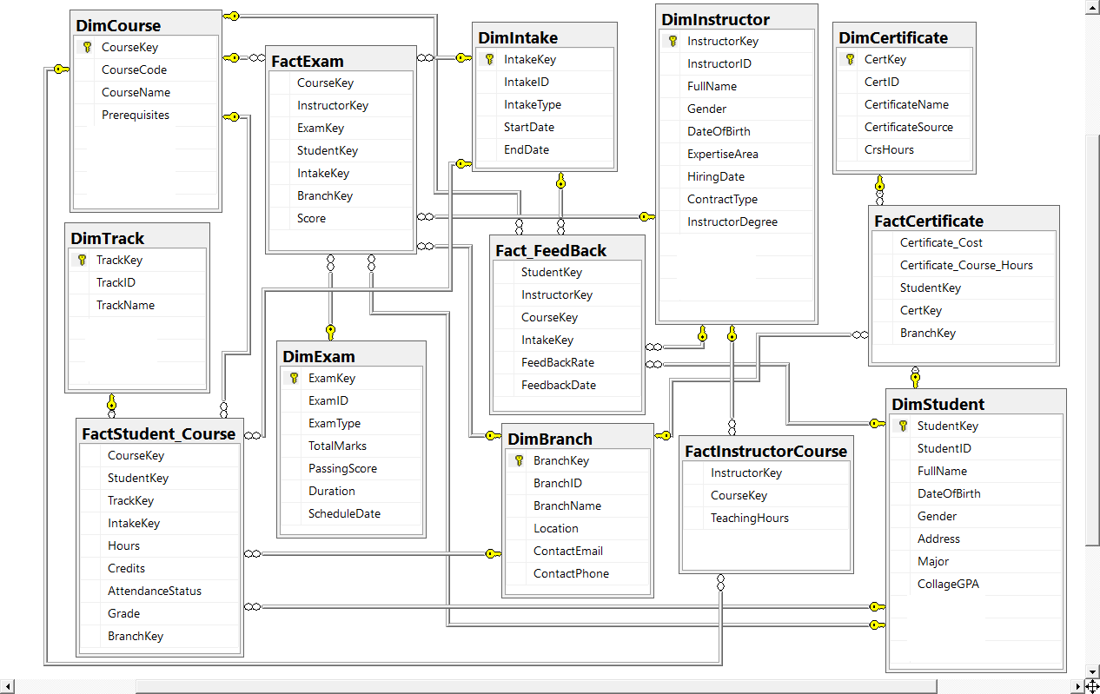
Data warehouse| Design
Galaxy Schema
Fact Tables:
Fact_Feedback
FactExam
FactStudent_Course
FactInstructorCourse
Dimensions:
DimExam
DimTrack
DimCourse
DimIntake
DimInstructor
DimCertificate
DimStudent
DimBranch

Slide 21
ETL
SSIS

Slide 22
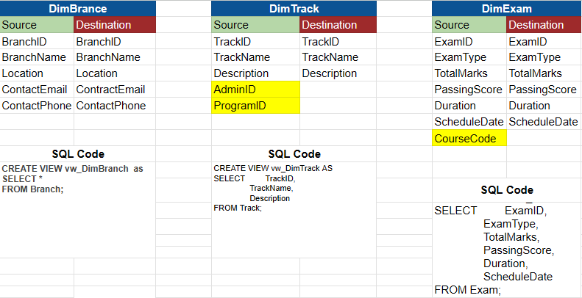
ETL | SSIS
Source Destination mapping

Slide 23
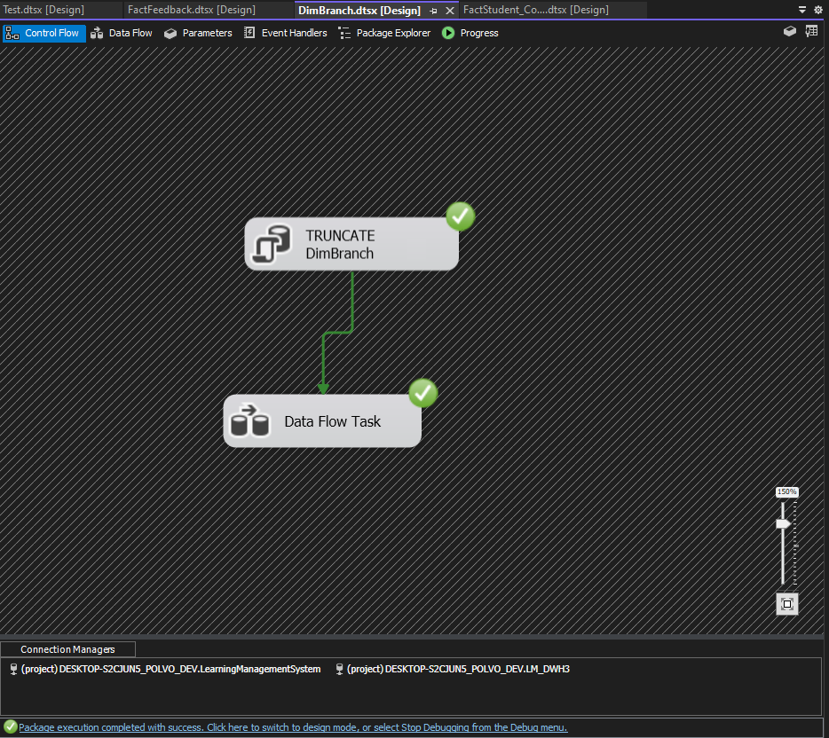
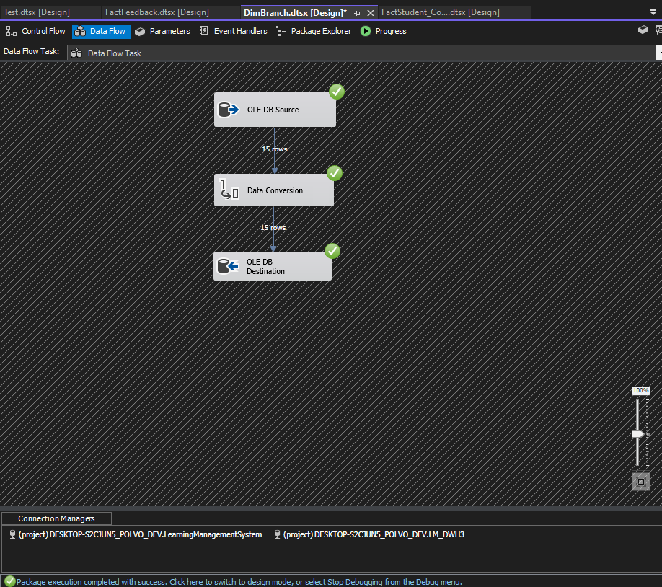
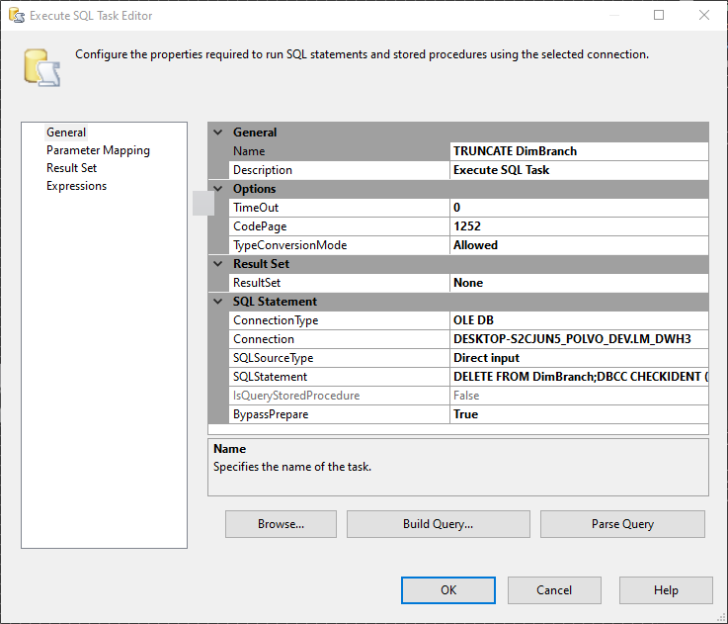
ETL | SSIS | DimBranch

Slide 24
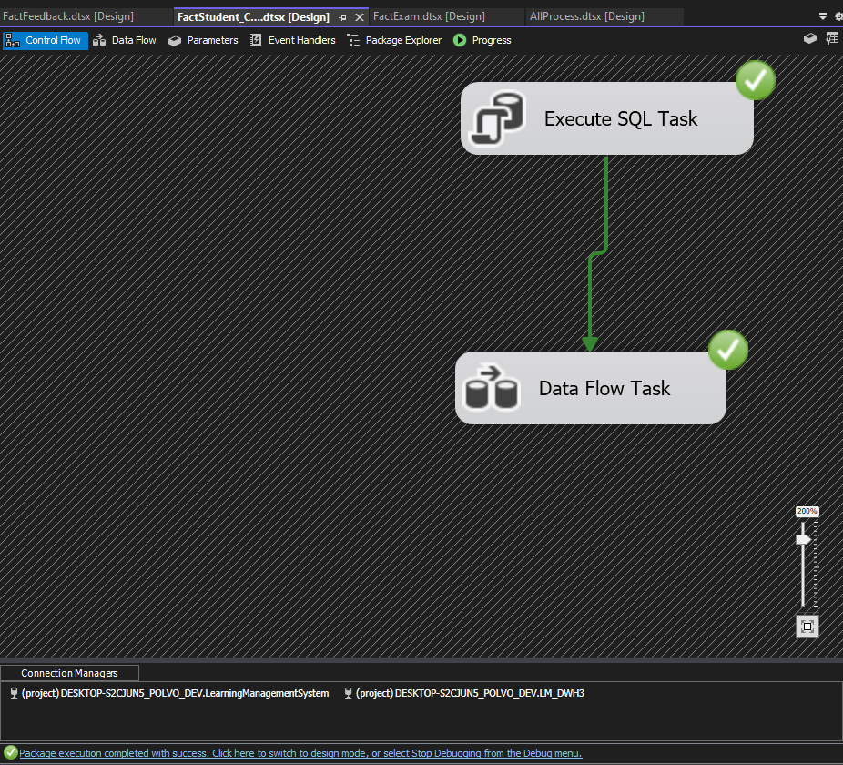
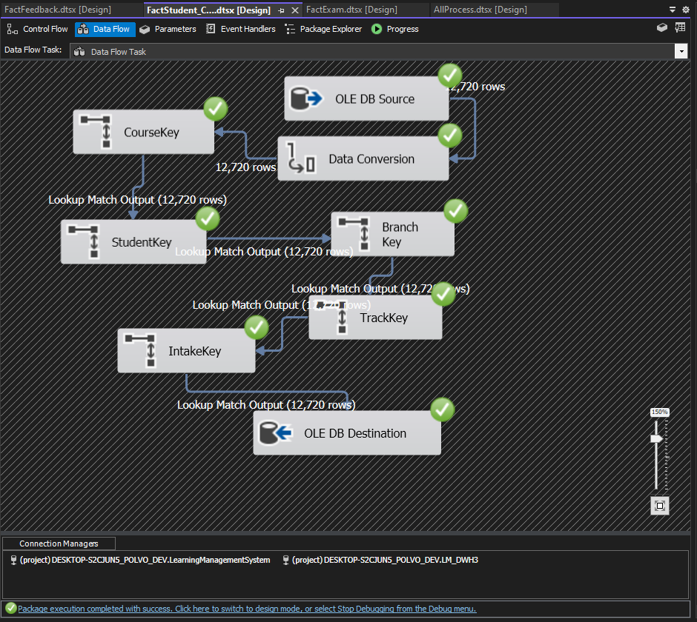
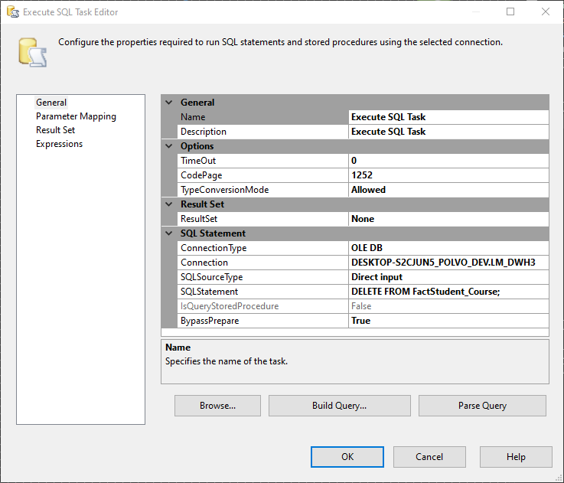
ETL | SSIS | Fact_StudentCourse

Slide 25
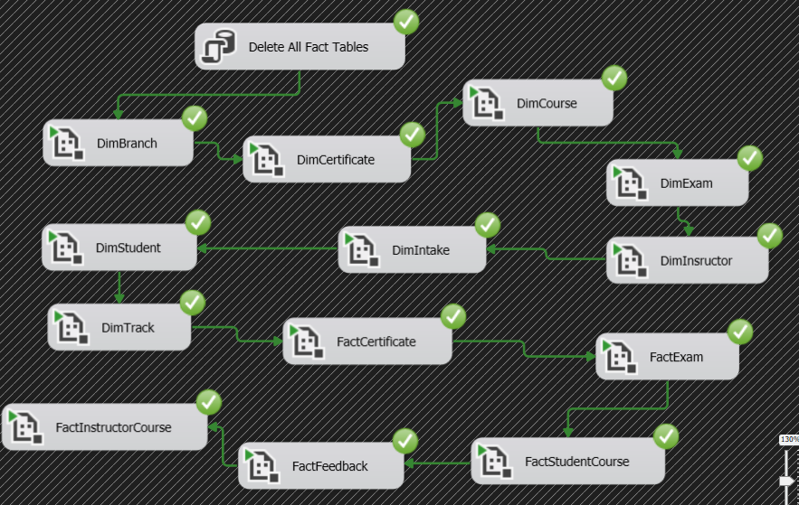
ETL | SSIS | Full Process

Slide 26
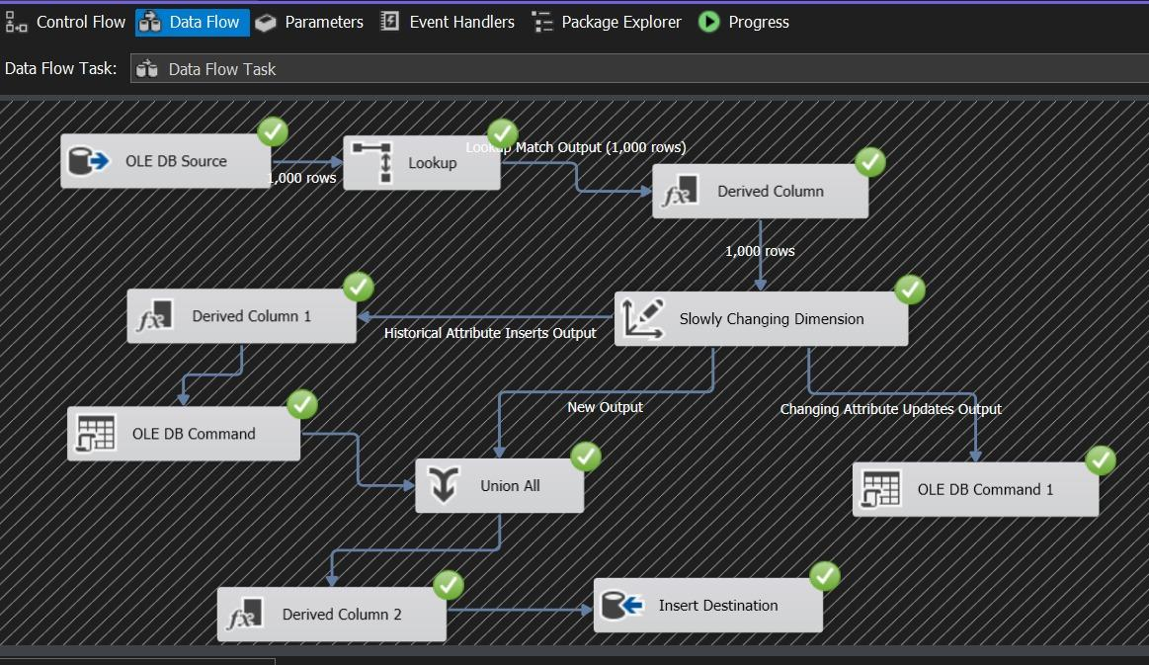
ETL | SSIS | DimStudent

Slide 27
Reporting
SSRS

Slide 28
Reporting
Exam Reporting Stored Procedures?
Get Student info by DP nomber
Returns student data given the department ID
Get the Grades by student ID
Displays the student Grades givens Student ID
Get Student Answers for Exam
Shows student-selected answers, option correctness, and timestamps

Slide 29
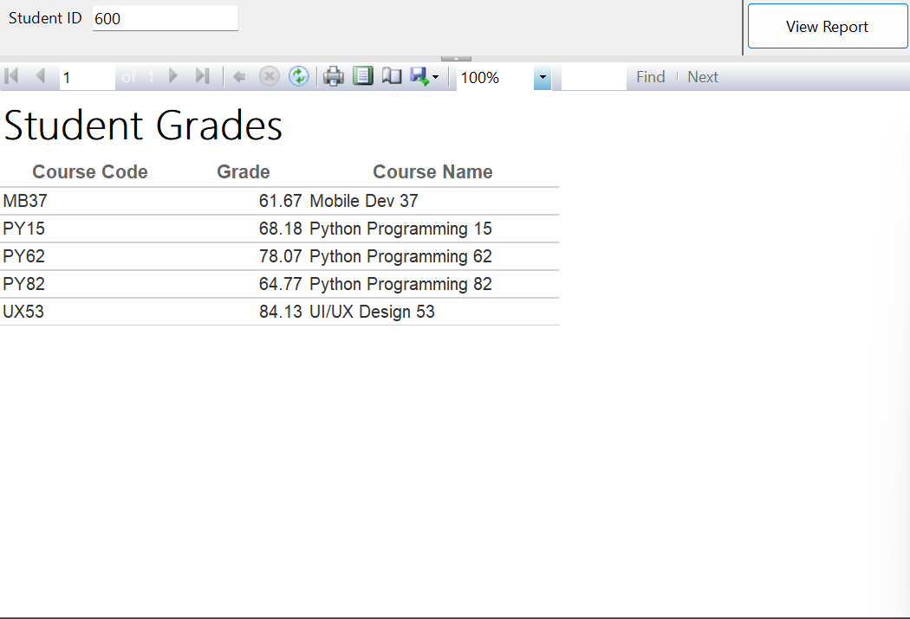
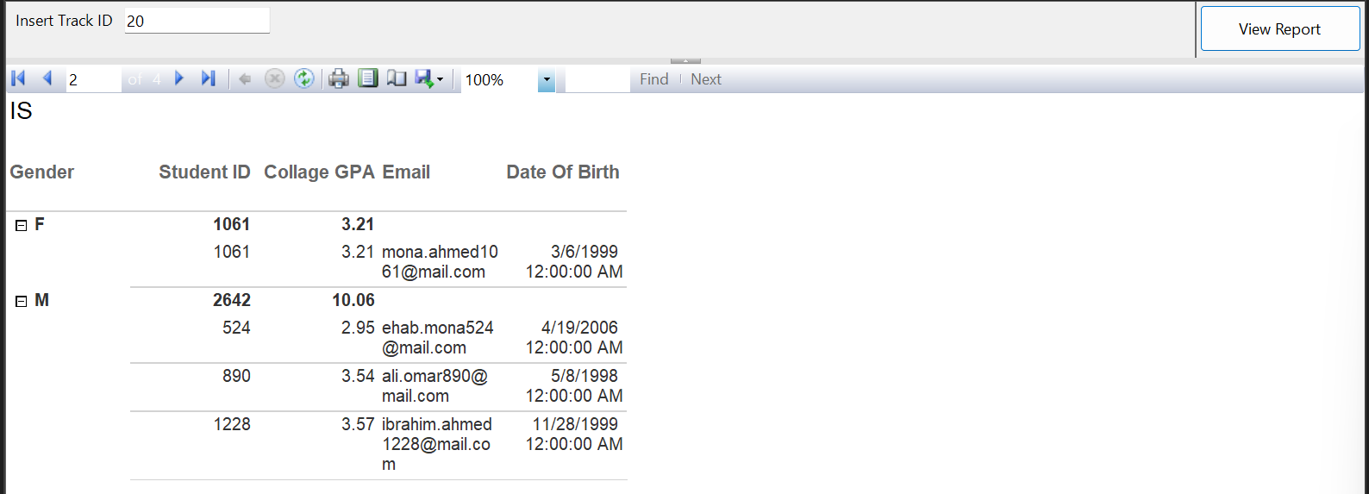
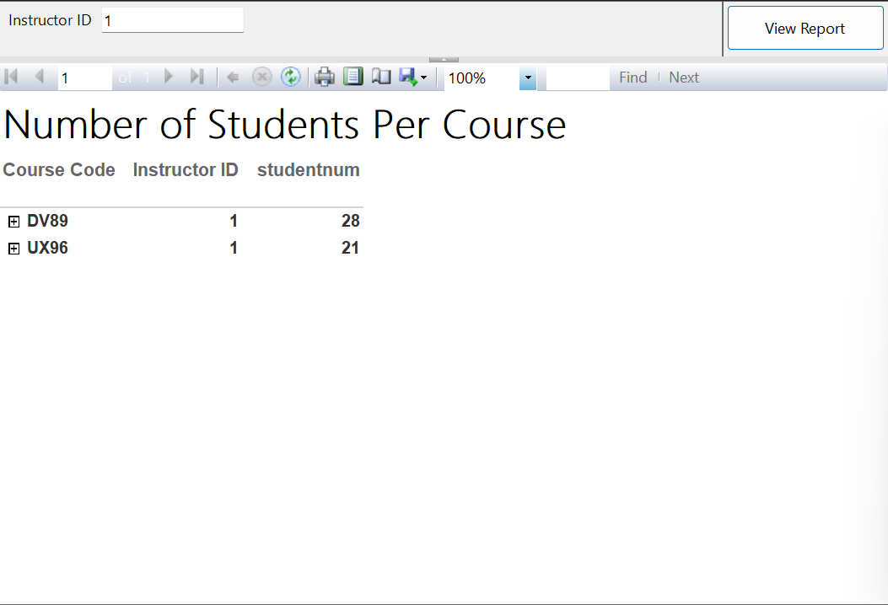
Reporting

Slide 30
Reporting
Exam Reporting Stored Procedures?
Get Topics by Course
Returns all topics related to a course using its code
Get Exam Questions with Options
Displays questions and their choices for a given exam
Get Student Answers for Exam
Shows student-selected answers, option correctness, and timestamps

Slide 31
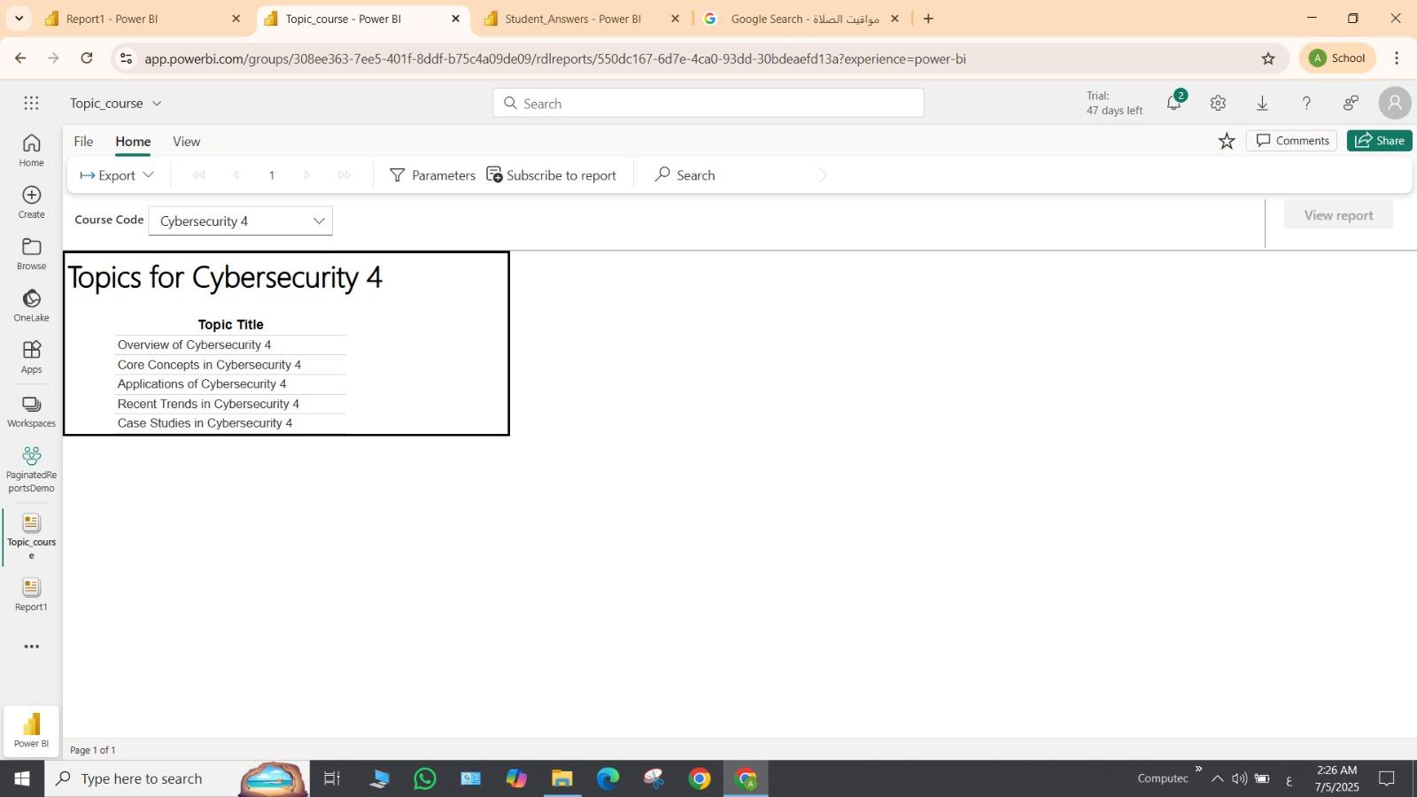
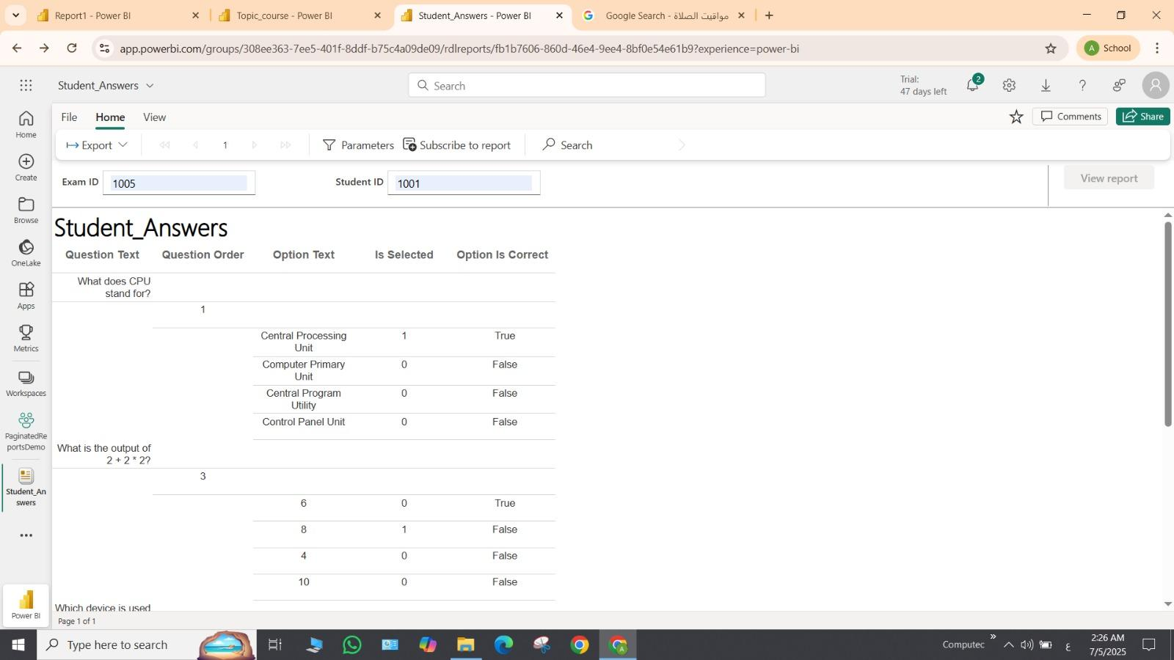
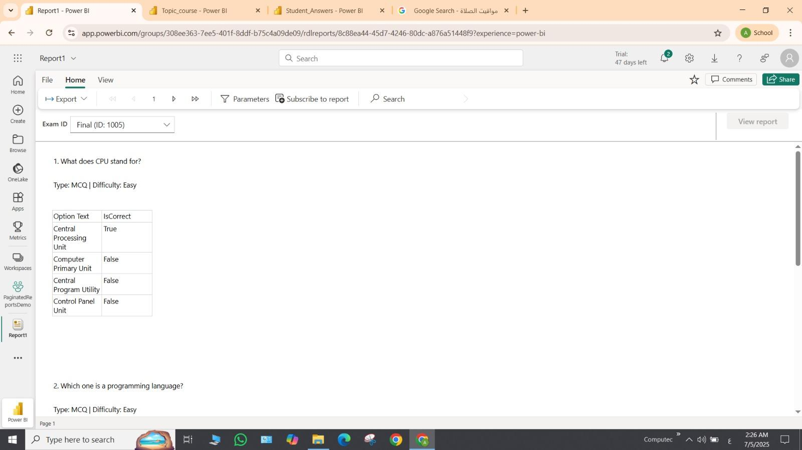
Reporting

Slide 32
Analysis
Power BI

Slide 33
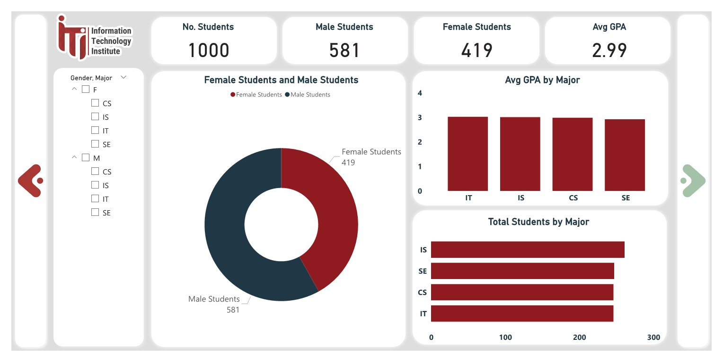
Power BI Dashboard
Student Overview Dashboard
1. Student OverView Dashboard

Slide 34
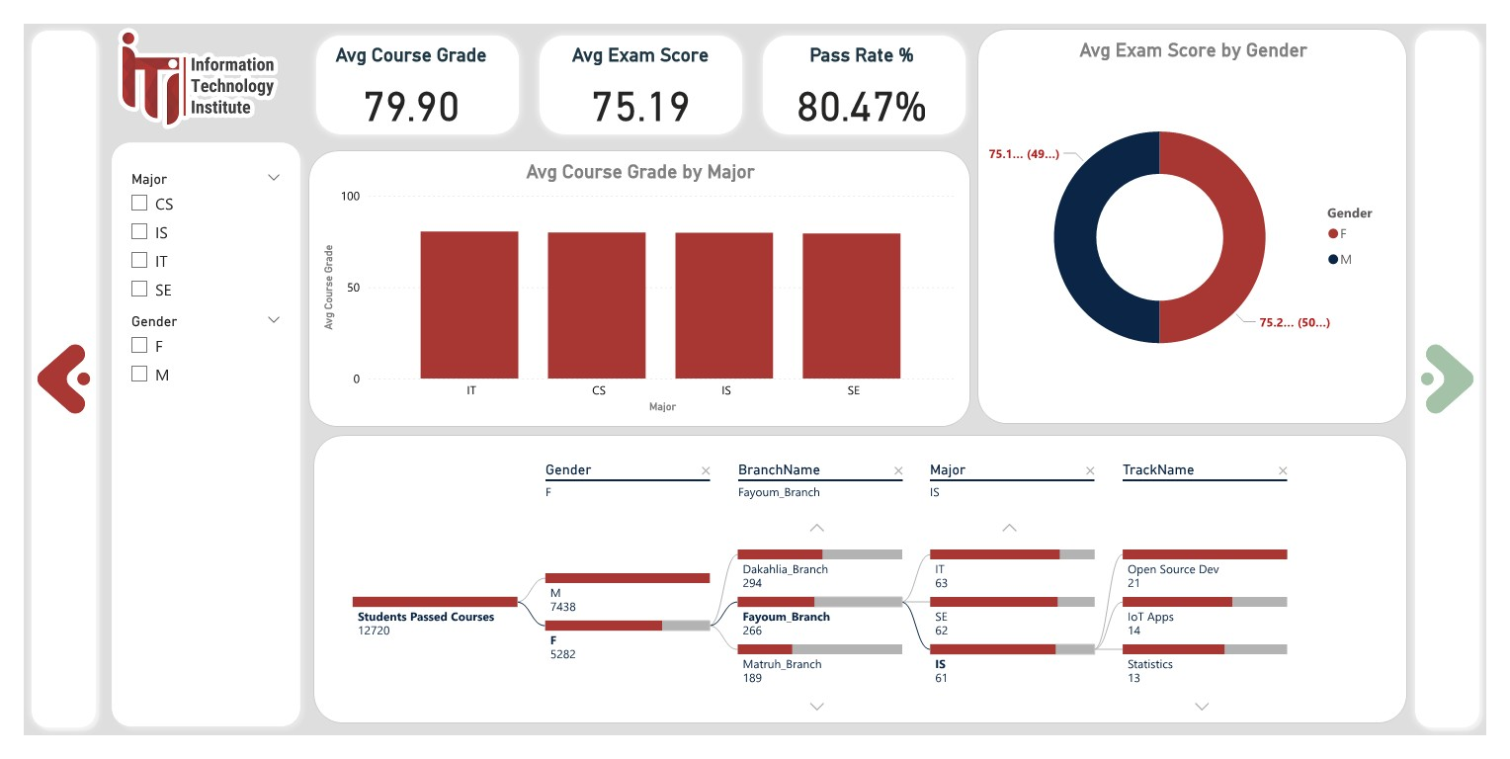
Power BI Dashboard
GPA by Track and Major

Slide 35
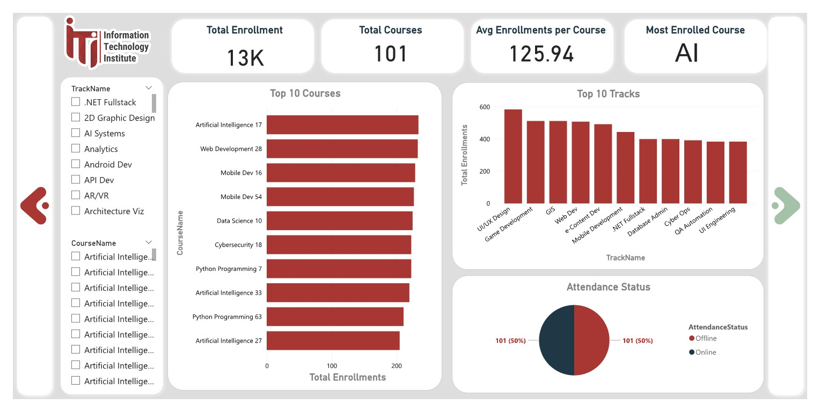
Power BI Dashboard
Course Enrollment Dashboard

Slide 36
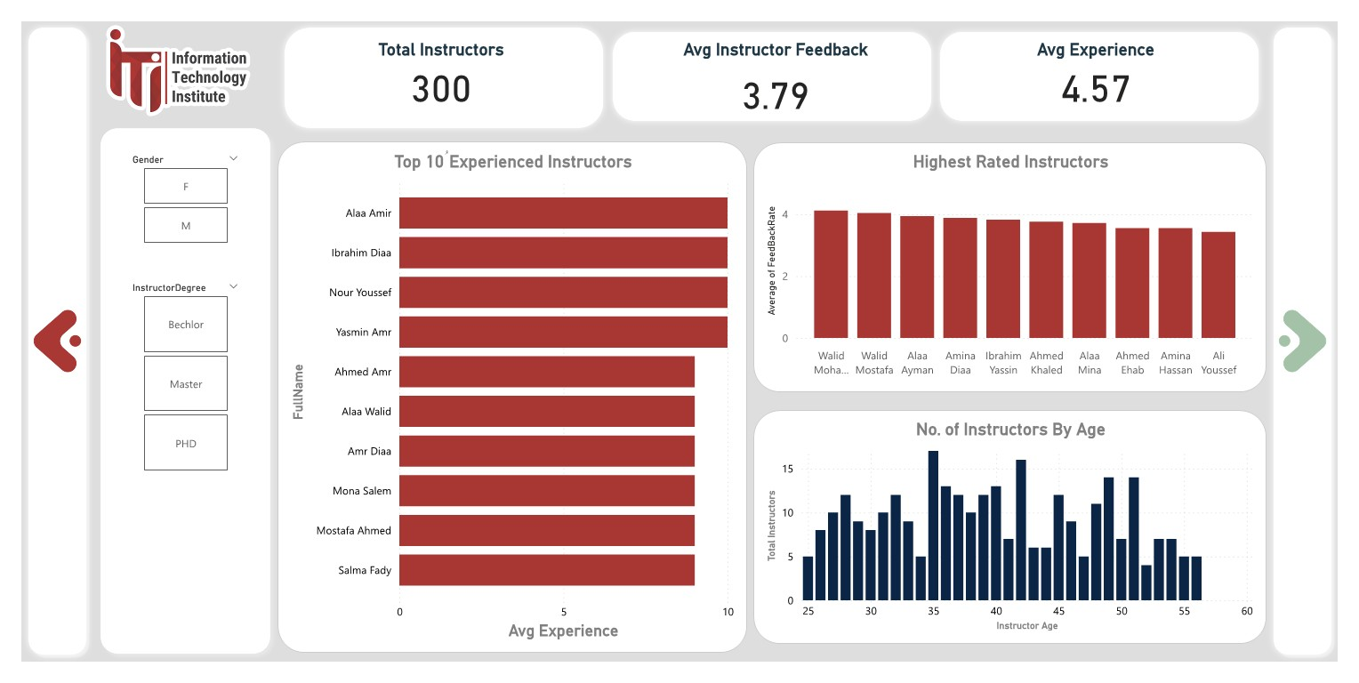
Power BI Dashboard
Instructor Insights

Slide 37
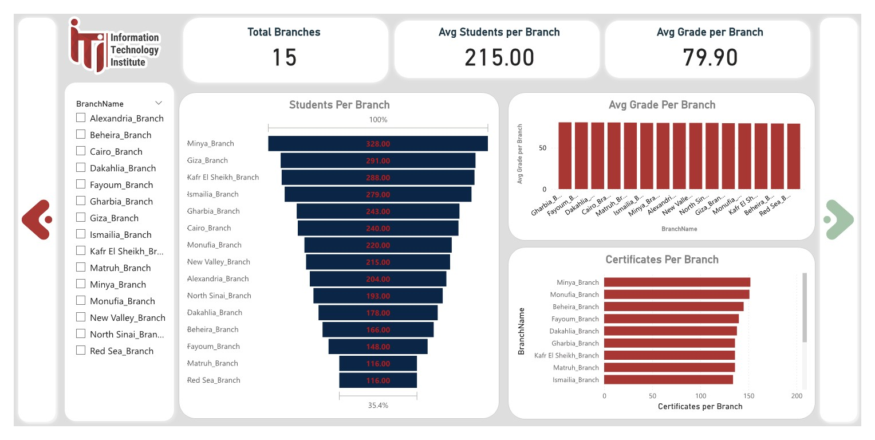
Power BI Dashboard
Branch Performance Dashboard

Slide 38
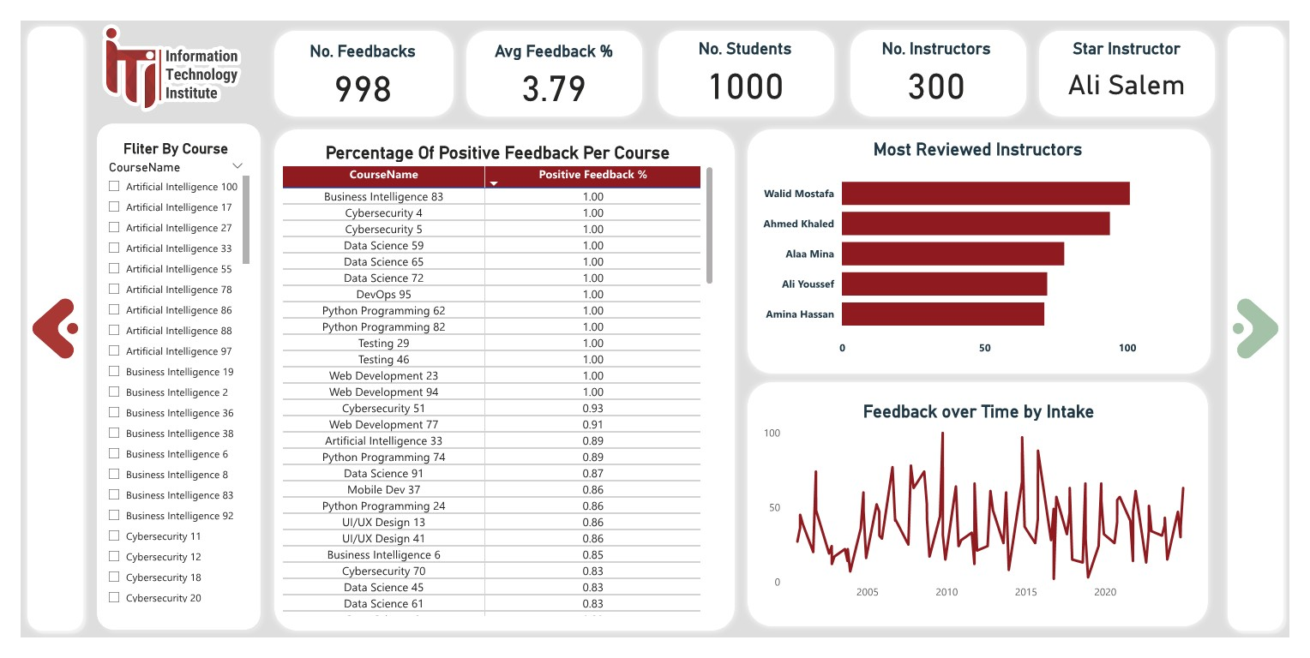
Power BI Dashboard
Feedback Dashboard

Slide 39
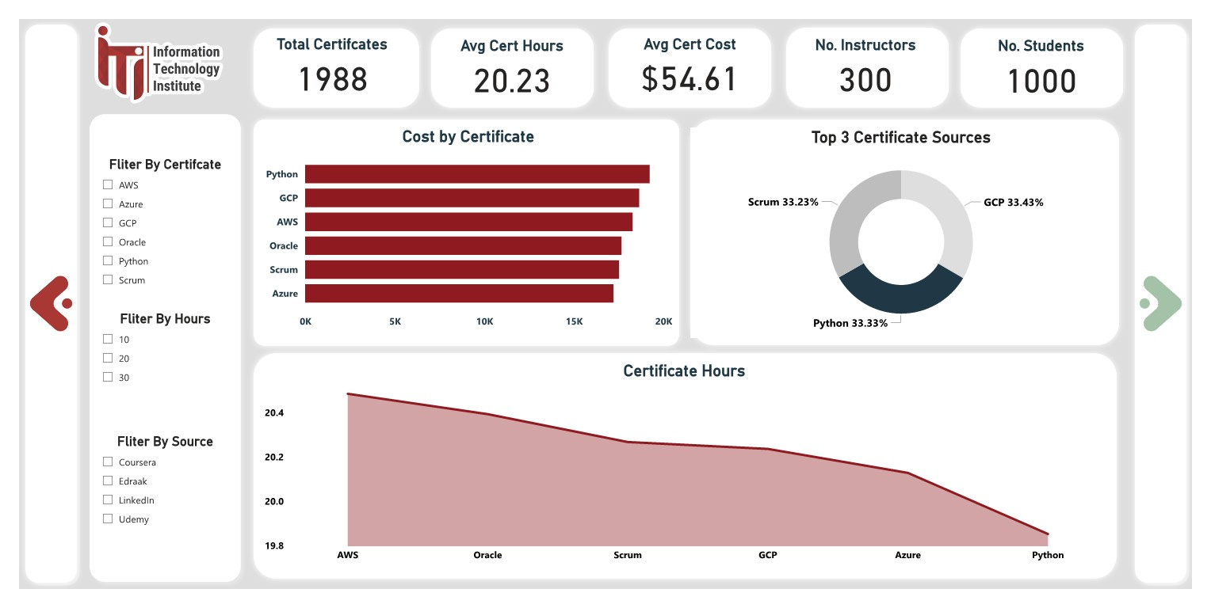
Power BI Dashboard
Certification Insights

Slide 40
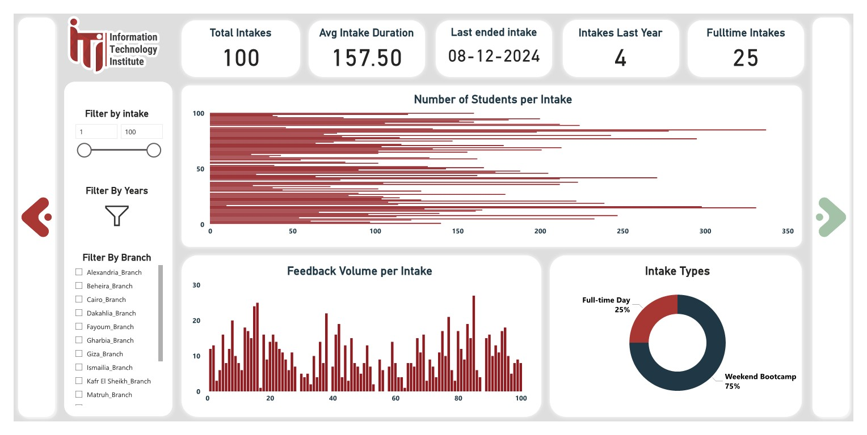
Power BI Dashboard
Intake Analysis

Slide 41
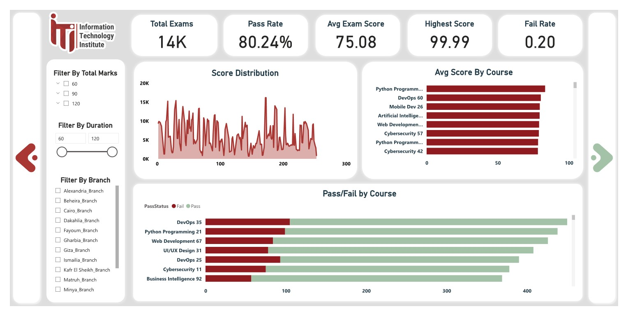
Power BI Dashboard
Exam Performance Dashboard

Slide 42
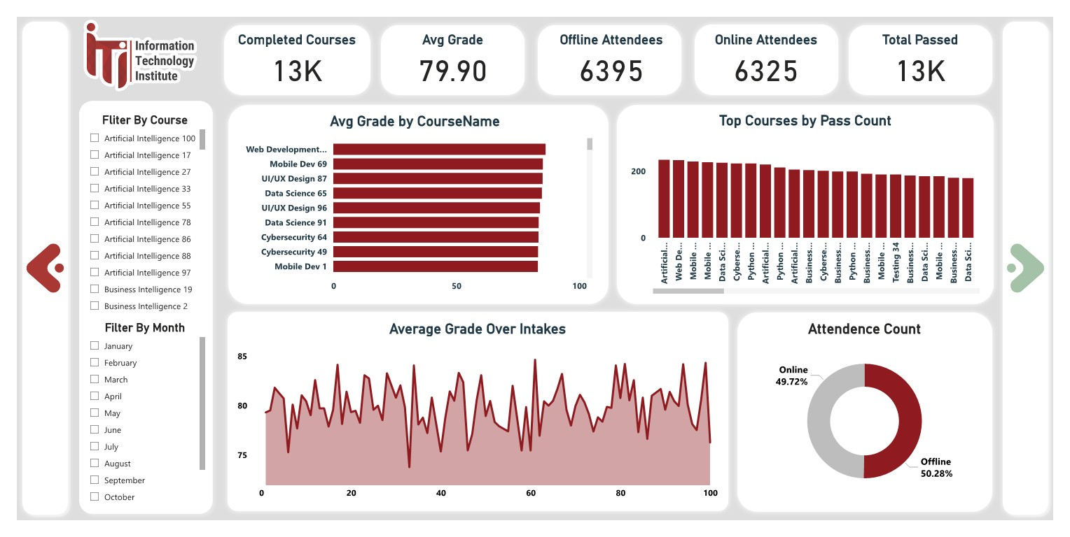
Power BI Dashboard
Course Completion

Slide 43
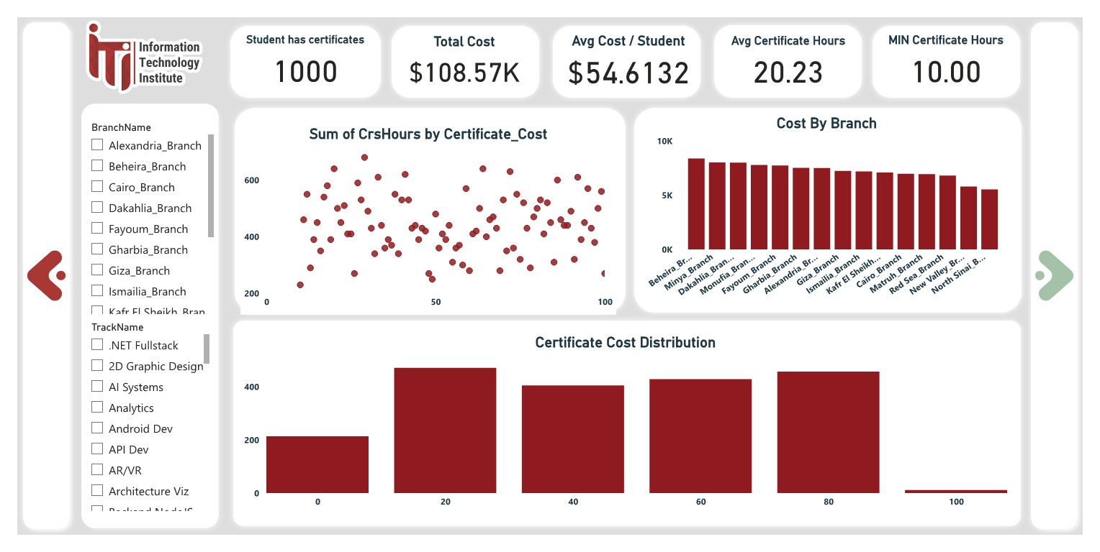
Power BI Dashboard
11.Student Certificate Summary

Slide 44
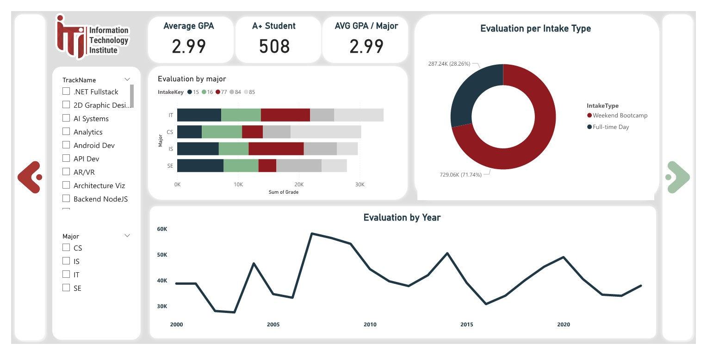
Power BI Dashboard
12.GPA Progression over Intake

Slide 45
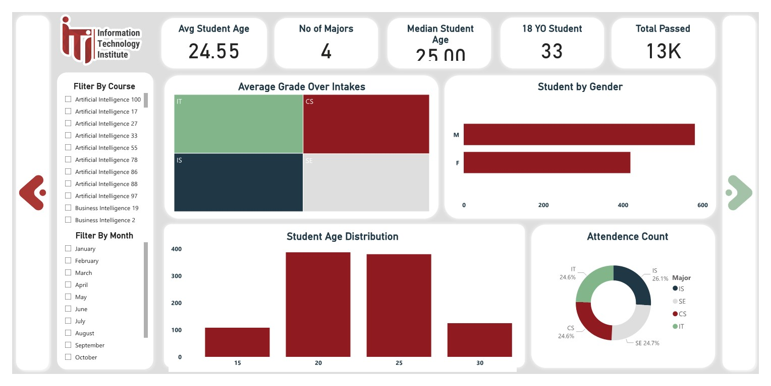
Power BI Dashboard
13. Student Demographics

Slide 46
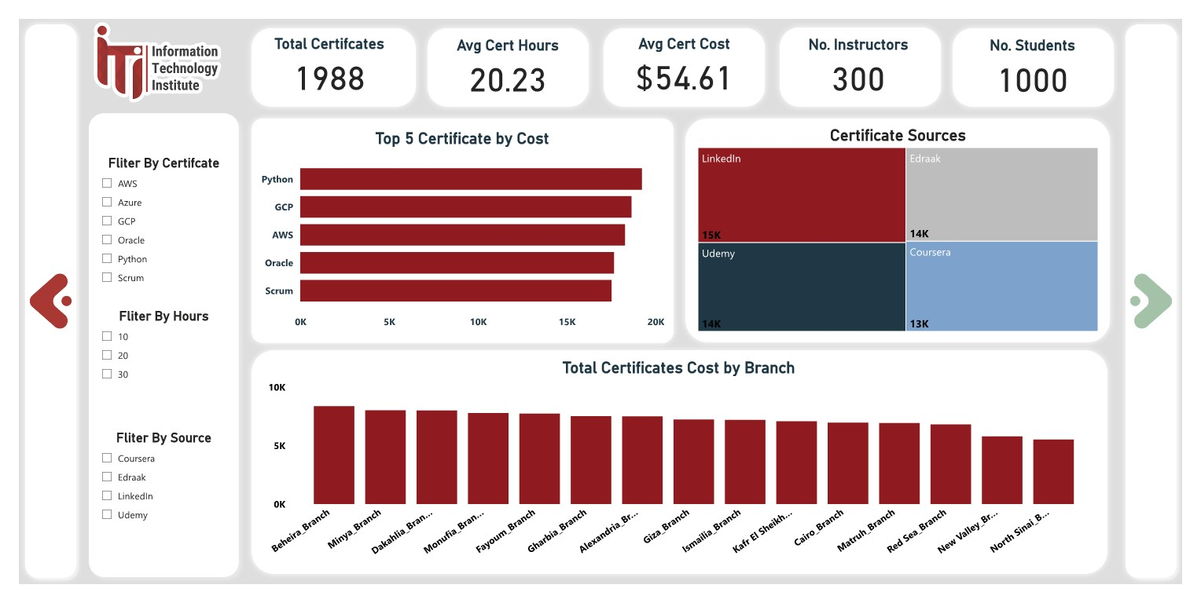
Power BI Dashboard
14. Certification Insights

Slide 47
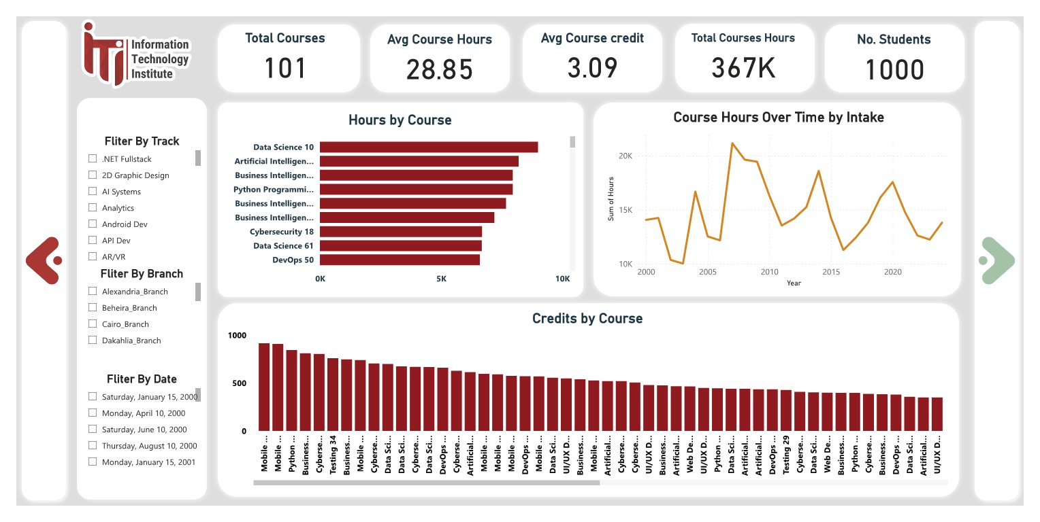
Power BI Dashboard
15. Student & course

Slide 48
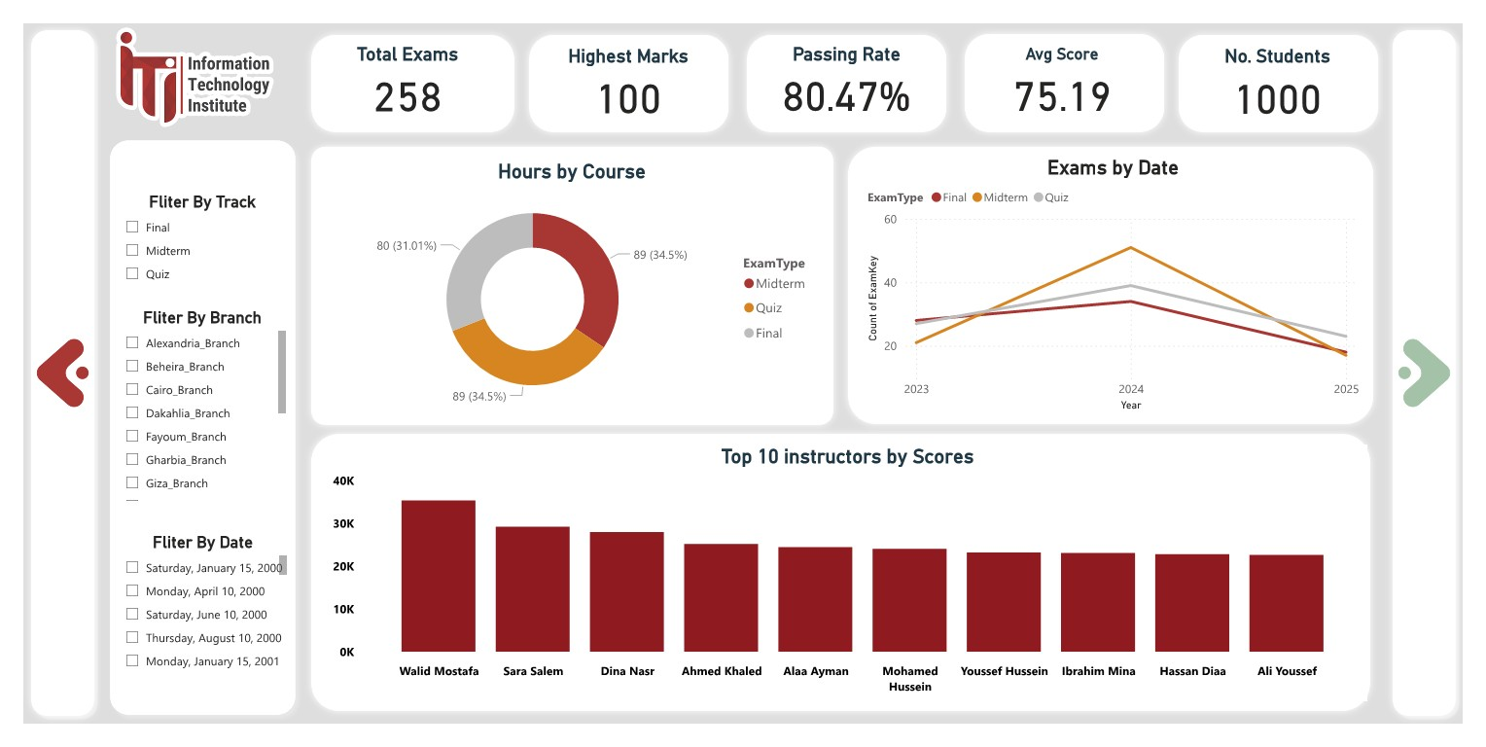
Power BI Dashboard
16.Exam

Slide 49
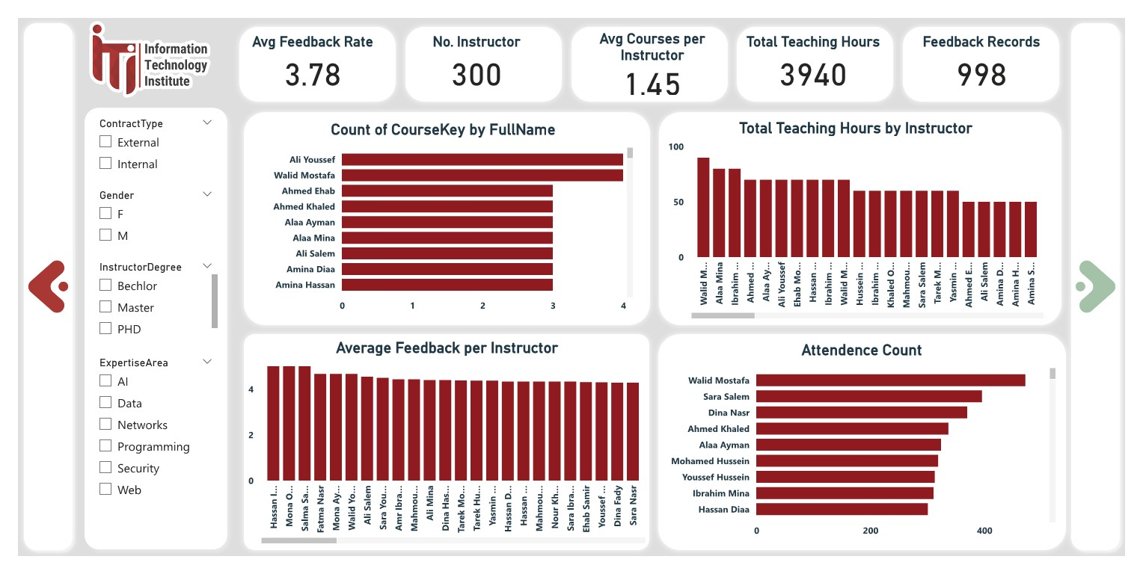
Power BI Dashboard
Instructor Load Dashboard

Slide 50
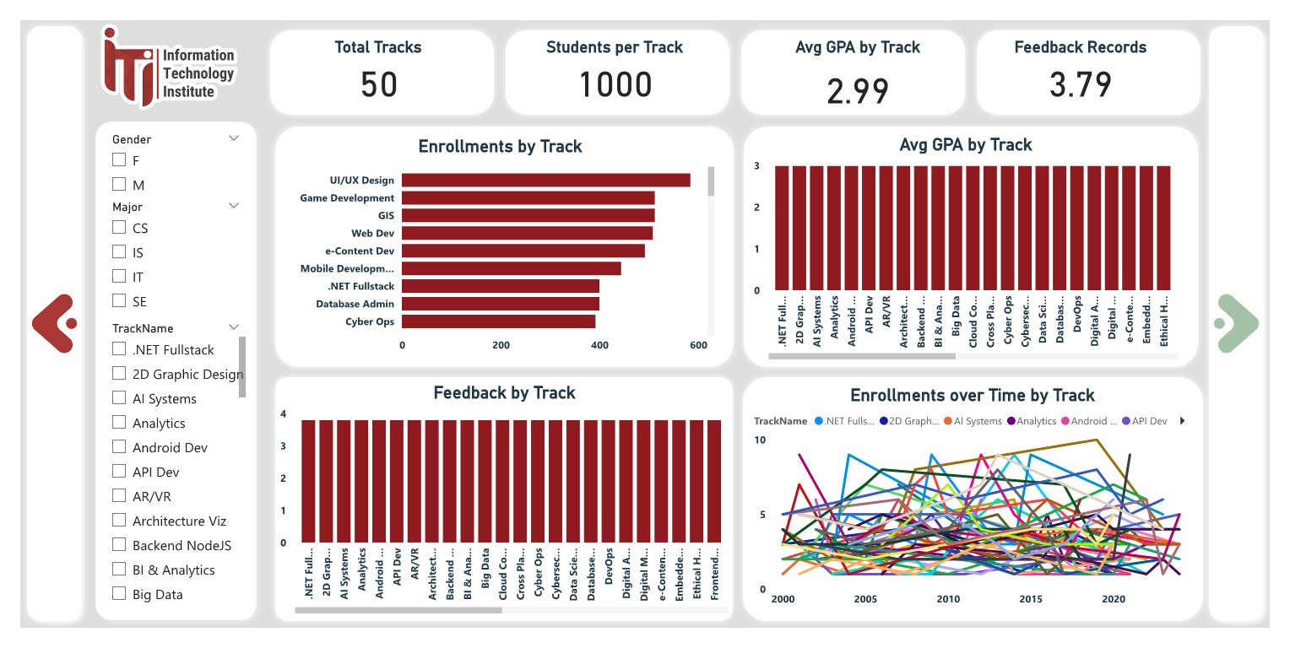
Power BI Dashboard
Track Popularity Dashboard

Slide 51
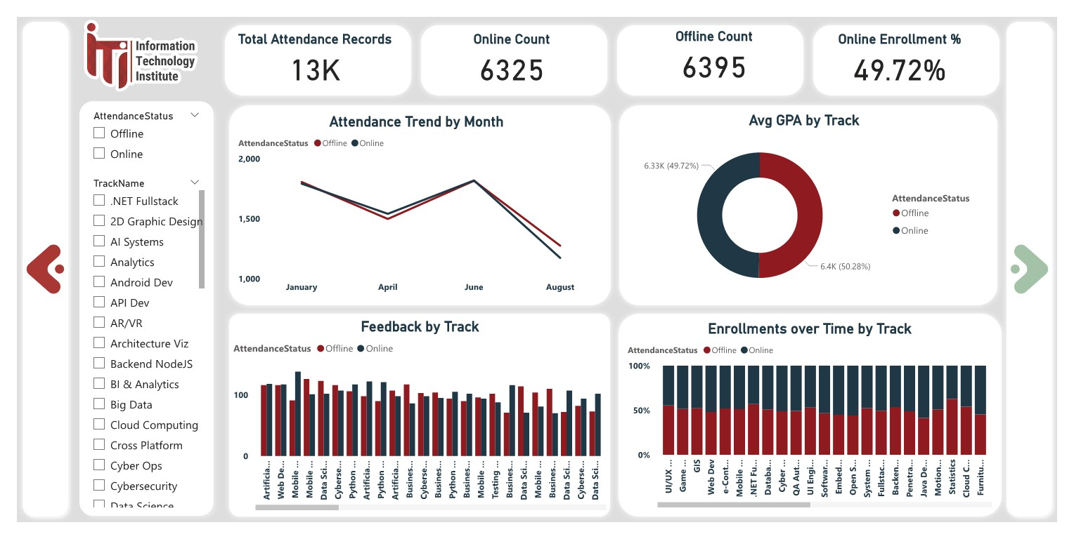
Power BI Dashboard
Attendance Trends Dashboard

Slide 52
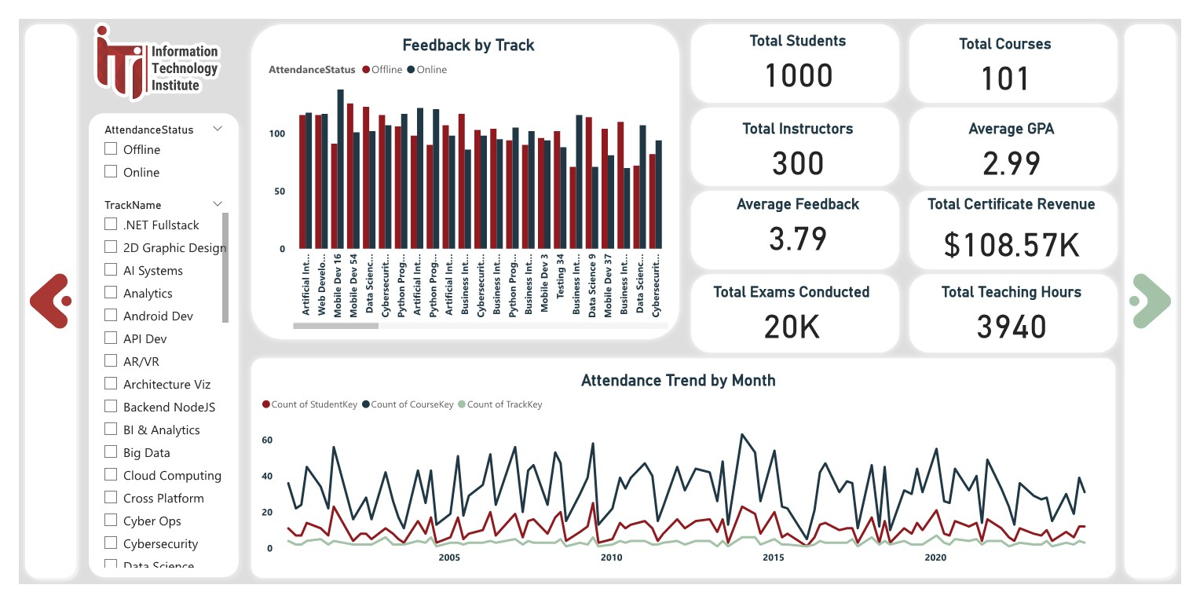
Power BI Dashboard
Summary KPI Dashboard

Slide 53
Application
Flet.dev | node.js

Slide 54
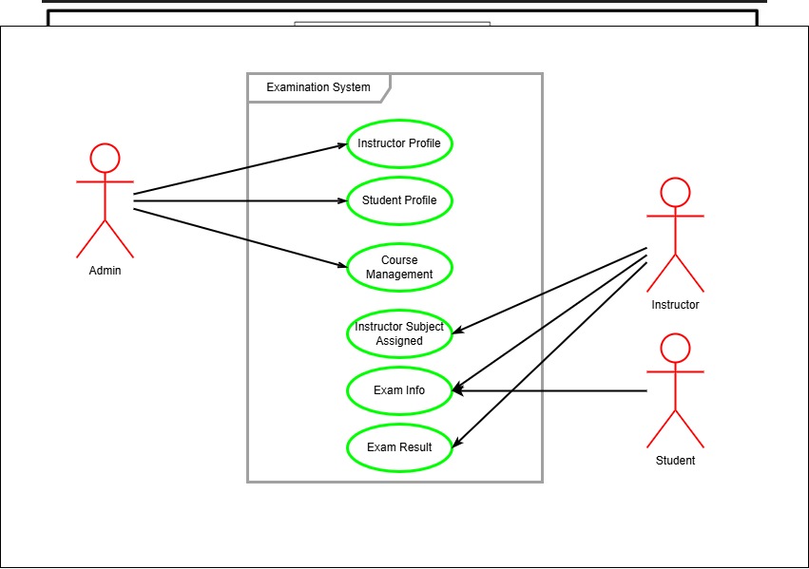
Application| Use case diagram

Slide 55
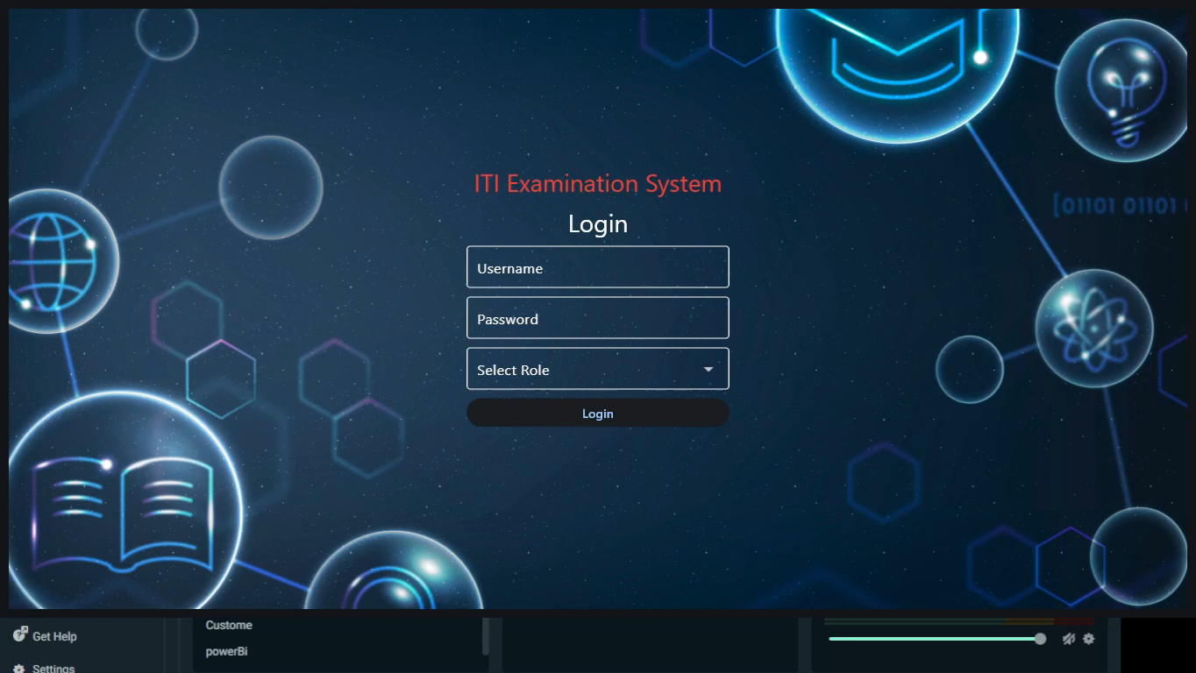
Application| Demo

Slide 56


Application| Front-End
Technologies Used in Front-End

Slide 57




Application| Back-End
Technologies Used in Backend

Slide 58

Application| Back-End
Backend Summary
We developed the backend of the Examination System using modern Node.js technologies. The backend is responsible for:
✅ Connecting to the SQL Server database using stored procedures
✅ Creating and managing API endpoints with Express.js
✅ Handling user login, exams, questions, student answers, and results
✅ Enabling external access and testing through ngrok
✅ Supporting CORS to allow frontend integration

Slide 59
Conclusion
…

Slide 60
Thank You!
Any Questions

